Slide 1


PROBLEM UNDERSTANDING AND OBJECTIVE
Incoming Request Processing Workflow
An AI prototype that classifies incoming customer requests and executes a distinct, multi-step remediation workflow for each type.
The Problem
The Objective
Every incoming request - complaint, enquiry, or service issue - is read and routed by hand, so speed and consistency depend on whoever picks it up
Urgent cases sit in the same queue as routine questions, so escalations get noticed late
Skilled agents spend their time working out what a message is, instead of resolving it
Classify every request by type and urgency the moment it arrives
Trigger the right remediation path automatically: draft the reply, route to the right team, set the follow-up
Keep humans firmly in control of critical and uncertain cases
Give operations leaders live visibility: volumes, case status, and measurable time and cost saved
Repository: github.com/yos-fatahillah/incoming-request-workflow • Deliverables: prototype, README, PRD, Product and Maintenance Document, sample inputs/outputs, demo recording

Slide 2








SOLUTION ARCHITECTURE AND DESIGN FLOW
Decision logic: confidence gates the override, then branch by type
Pipeline
Incoming Request
Intake
Form / upload / simulated inbox
Request classified by LLM
Classification
confidence == High?
Classify
Claude: type, urgency, confidence
NO
YES
Safety Check
Branch on request_type
Force-route to Escalation
(human review)
Confidence = Low → override
Branch
High
Low
Medium
Critical
Complaint
General Enquiry
Service Request
Escalation
Route by request_type
Acknowledge
↓
Escalate
↓
Log Priority
↓
2h follow-up
Sub-topic
↓
Knowledge Based Response
↓
Send
↓
Log resolved
Extract
↓
Route Department
↓
Confirm
↓
SLA Timer
Flag human
↓
Draft Acknowledgement
↓
Notify Supervisor
↓
Pause Auto
Log
SQLite audit trail
Dashed line: the low-confidence override and a direct “Escalation” classification both land on the same remediation branch.

Slide 3


IMPLEMENTATION HIGHLIGHTS
Built on Claude classification + a confidence-gated override
Tech Stack
workflows.py — run_workflow()
Python 3 — orchestration: classifier.py, workflows.py, storage.py
if confidence == "Low" and \
request_type != "Escalation":
result = handle_escalation(
request_id, text, classification
)
result["override_applied"] = True
result["override_reason"] = (
f"Low confidence on '{request_type}' "
"-> auto-escalated to human review"
)
return result
handler = BRANCH_MAP.get(
request_type, handle_general_enquiry
)
return handler(request_id, text, classification)
Claude API (claude-sonnet-4-5) — classification + draft generation
Streamlit — 3-tab UI: intake, batch run, dashboard
SQLite + Pandas — audit trail, dashboard aggregation, CSV export
Branching & Reasoning Design
Classifier self-reports confidence, not just a label — used directly as the override trigger
Department routing inferred by keyword match (billing / technical / account / shipping / general)
Offline keyword-fallback engine mirrors the same branch/step contract — pipeline never goes down

Slide 4


CHALLENGES AND LEARNINGS
What broke, what we watched out for, and what it taught us
Bug: over-eager override
Trade-off: draft-then-hold for Escalation
The offline fallback flagged every signal-free message as low-confidence, sending all enquiries to review. Fixed by limiting that to short, vague, question-mark-free text.
Critical cases get a drafted reply that is held, not auto-sent - a human always reviews it before an upset customer sees it.
Trade-off: keyword department routing
Challenge: overreliance on the LLM
Keyword-matched routing is fast and fully explainable to an ops team, but coarser than letting the model pick the department directly.
Trusting one model for both classification and drafting is a single point of failure. Countered with the confidence override, draft-then-hold, and an offline fallback.
Challenge: no way to quantify output quality
Learning: the hard part isn't the build
No accuracy metric exists beyond manually reading case traces. A labelled evaluation set with a confusion matrix is the top v2 priority.
Wiring the pipeline was the easy part. The real work was tailoring it to real pain points - the PRD was built by walking through the agent, supervisor, and admin perspectives first.

Slide 5
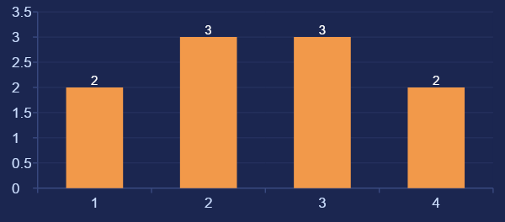
DEMO SUMMARY AND NEXT STEPS
Classified, remediated, reviewed by a human, and audited — end to end
4
70%
✓
✓
Remediation branches
Auto-handled (deflection)
Human review queue built-in
Live email alerts to stakeholders
Sample Run — Volume by Type
Next Steps
Labelled evaluation set to measure classification accuracy; model-driven department routing
Case threading — link repeat contacts from the same customer and auto-escalate
Urgency-scaled SLAs and follow-ups; Slack alerts and ticketing integration (e.g. Zendesk)
Feedback loop: learn from human reclassifications to refine the classifier prompt
Repository: github.com/yos-fatahillah/incoming-request-workflow • Deliverables: prototype, README, PRD, sample inputs/outputs, demo recording

